Slide 1

Predicting customer buying behaviour
21/08/2024 BY : Neel Bhavsar

Slide 2
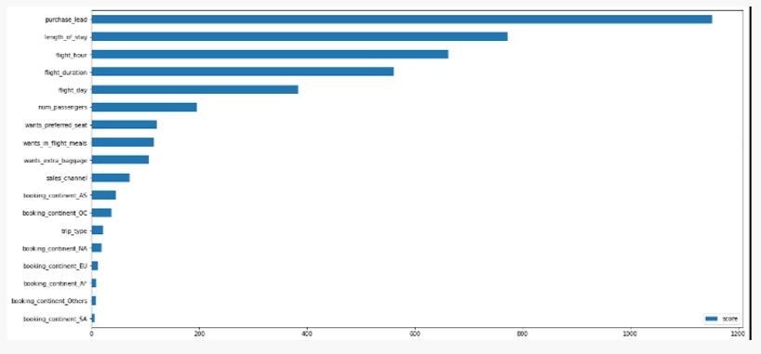
predictive model to understand factors that influence buying behaviour
From our feature importance from our model, we know that the influencing factors for customers to complete their bookings are purchase_lead (namely the time gap between the order time and the flight) and length_of_stay (namely how long the customer will occupy the destination).
Then the area where the customer orders does not affect whether the customer will complete the booking or not

